Slide 1
Improving matching through Job Fairs
Presentation Outline
Literature
RCTs
Motivation
Research design
Partners
Baseline Survey
Job fair day
Results

Slide 2
Literature
Few studies have looked at job fairs using RCTs as a venue for efficient matching, most famous Franklin, 2017 (Ethopia), Abebe et al., 2017 (Ethiopia) and Beam, 2016 (Philippines)
Studied the effect of transportation subsidies on job search
Beam and Abebe et al. also studies the effect of information treatments on labor market outcomes
Abebe et al. and Franklin used door to door sampling

Slide 3
What’s different about our study?
Measures interactions of beliefs and valuations of opportunities, wages and decent jobs in the labor market and the job fair,
How do these interactions affect our outcome variables?
  Chance of getting job at a job fair
  Expected salaries at the fair
  % decent jobs in fair
  How hard it is to find a job?
  Reservation wage
  Importance of social and medical insurance

Slide 4


What is the Intuition behind Randomized Evaluations?
Randomized Evaluations go by many names:
Randomized Controlled Trials, Social Experiments, Random Assignment Studies, Randomized Field Trials, Randomized Controlled Experiments
Two groups continue to be identical, except for treatment
Any differences in outcomes between the groups can be attributed to the program
Intervention
Population is randomly split into 2 or more groups
Outcomes for both groups are measured
Comparison
Notes:
Before the program starts, eligible individuals are randomly assigned to two groups so that they are statistically identical before the program.
This is unlike other types of impact evaluation: pre-post, simple difference (explain)

Slide 5
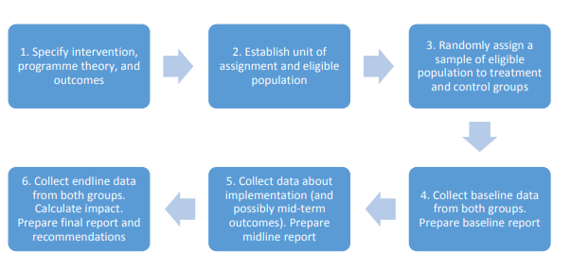
Overview of conducting an RCT
White, H., Sabarwal S. & T. de Hoop, (2014). Randomized Controlled Trials (RCTs), Methodological Briefs: Impact Evaluation 7, UNICEF Office of Research, Florence.

Slide 6
Motivation
  11.7% unemployment rate 2017 (WB).
  29.6% youth unemployment rate in 2017 (WB).
  600,000 unfilled jobs in the private sector in 2011
Mismatch between the labor supply and demand. This is the reason we decided to conduct an impact evaluation on job fairs in Egypt
Project aims to improve our understanding of the contribution of job fairs in the labor market behavior of jobseekers and how job fairs can be improved to ensure higher attendance and better job matching
Test if information frictions regarding job fairs and the labor market exist
Test if capital constraints negatively affect the job search behavior and outcomes

Slide 7
Research Design
Door to door survey
Cluster level randomization: by building
7 groups
 | No Voucher | Voucher
Pure control: Survey only | T0 | N/A
Basic info about job fair | T1 | T1s
Wage info | T2 | T2s
Decent job info | T3 | T3s
Notes:
T0: Control, given survey only
T1: Gave job seeker a basic flyer with the date and address of the job fair
T1s: same treatment as T1 but offer a voucher redeemable at the job fair
T2: T1+ job fields, a salary scale, matching rate in previous job fair
T2s: same treatment as T2 but offer a voucher redeemable at the job fair
T3: T2+ info on decent jobs: minimum salary, formal contracts, social insurance, paid vacations abidance by the Egyptian labour law and providing a working environment where employees are respected
T3s: same treatment as T3 but offer a voucher redeemable at the job

Slide 8
Research Design
T1: Gave job seeker a basic flyer with the date and address of the job fair
T1s: same treatment as T1 but offer a voucher redeemable at the job fair
T2: T1+ job fields, a salary scale, matching rate in previous job fair
T2s: same treatment as T2 but offer a voucher redeemable at the job fair
T3: T2+ info on decent jobs: minimum salary, formal contracts, social insurance, paid vacations abidance by the Egyptian labour law and providing a working environment where employees are respected
T3s: same treatment as T3 but offer a voucher redeemable at the job fair

Slide 9



Partners

Slide 10
Baseline Survey
We participated in 2 job fairs with Shaghalni
  Sohag (April 8, 2019)
  Cairo (November 23rd, 2019) → Still cleaning and analysing data

Slide 11
Baseline Survey: Sohag
The Sohag fair that targeted Upper Egypt
Job fair took place April 8 2019 in Sohag University
Steps:
  Mapping of areas of recruitment
  Census using mapped districts asking for job seekers aged 18-35 → Database of job seekers for our sample (1 week)
  Revisited job seekers using census data to conduct baseline and give out our information and transportation treatments (2 weeks)
  Reached 2,474 job seekers in 1,321 buildings. 34% females
Notes:
Steps:
Mapping of areas of recruitment
A database of job seekers is to be created through a census using the mapped districts. Surveyors would visit apartments in each building and ask for job seekers aged 18-35. Names, addresses, mobile numbers and time availability were recorded on the tablet for the surveyors to visit the following week to conduct the baseline survey and give the information intervention
Baseline: Job seekers were revisited and baseline survey was conducted. After baseline treatments in the form of information and transportation vouchers were given to participants. Treatments were determined on the spot using SurveyCTO on tablet.

Slide 12
Job fair day
Total attendance: 681 job seeker
50% of attendees came through our door to door recruitment
14% of our sample showed-up
Evidence that more information, especially on wages resulted in higher attendance to job fairs
Transportation subsidy also lead to higher attendance

Slide 13
Results

Slide 14
Results
5 percentage points increase by just giving info
Info only increased attendance by 68%! (7.2%→ 12.1%)

Slide 15
Results
By telling them about wages, attendance more than doubled!
7.2% → 16%

Slide 16
Results
Voucher increased attendance by 2.9 percentage points
Less than just telling people about the job fair
Cash constraints exist, but not as huge as information frictions

Slide 17
Results
Unexpected results for the decent job treatment

Slide 18
Results by gender

Slide 19
Results by gender
Impact of info frictions is at least as twice as imp as the impact of transportation cost constraint for males

Slide 20
Results by gender
Info only isn’t as strong for women
Decent is better for women than for men
Voucher is more imp for women

Slide 21
Beliefs about the labour market
Women find it harder to get a job
Women have lower expected salary & reservation wage
Women rated the imp of having a safe working environ higher than men
 | Mean
 | Male | Female
Opportunities
Hardness in finding job scale | 8.118 | 8.342
Expected no. of months till finding a job | 61.38 | 66.93
Wages
Expected salary given experience | 2302.7 | 1607.1
Reservation wage | 2075.9 | 1493.6
Decent job
Formal contract importance | 8.216 | 8.097
Safe working environment importance | 8.338 | 8.925

Slide 22
Beliefs about the job fair
Women have lower expectations of opportunities and salaries at the job fair
Women have higher expectations of the % of decent jobs at the job fair
 | Mean
 | Male | Female
Opportunities
% getting job at the job fair | 48.49 | 47.05
Wages
Average salaries at the job fair | 1782.7 | 1390.8
% job offered at fair would provide acceptable salary | 37.20 | 34.25
Decent job
% decent jobs at job fair | 42.49 | 42.89

Slide 23
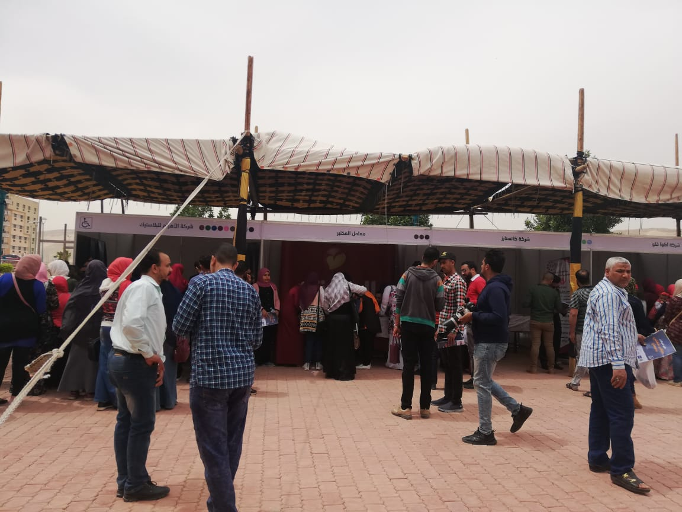

Slide 24
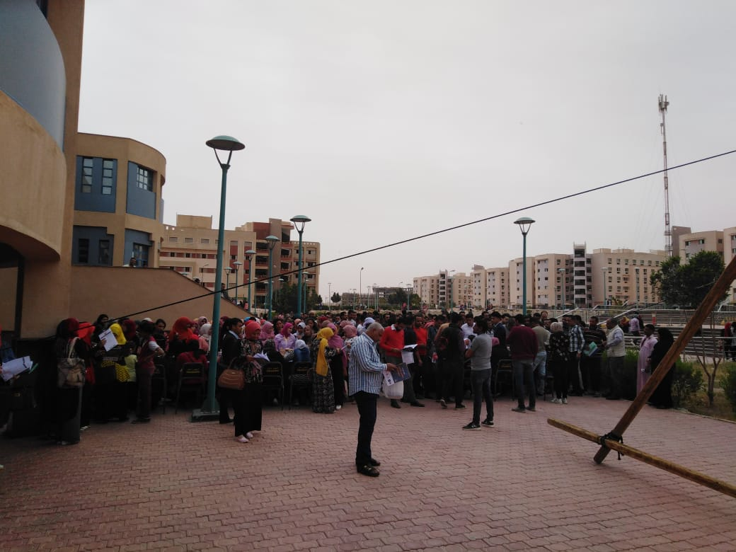

Slide 25

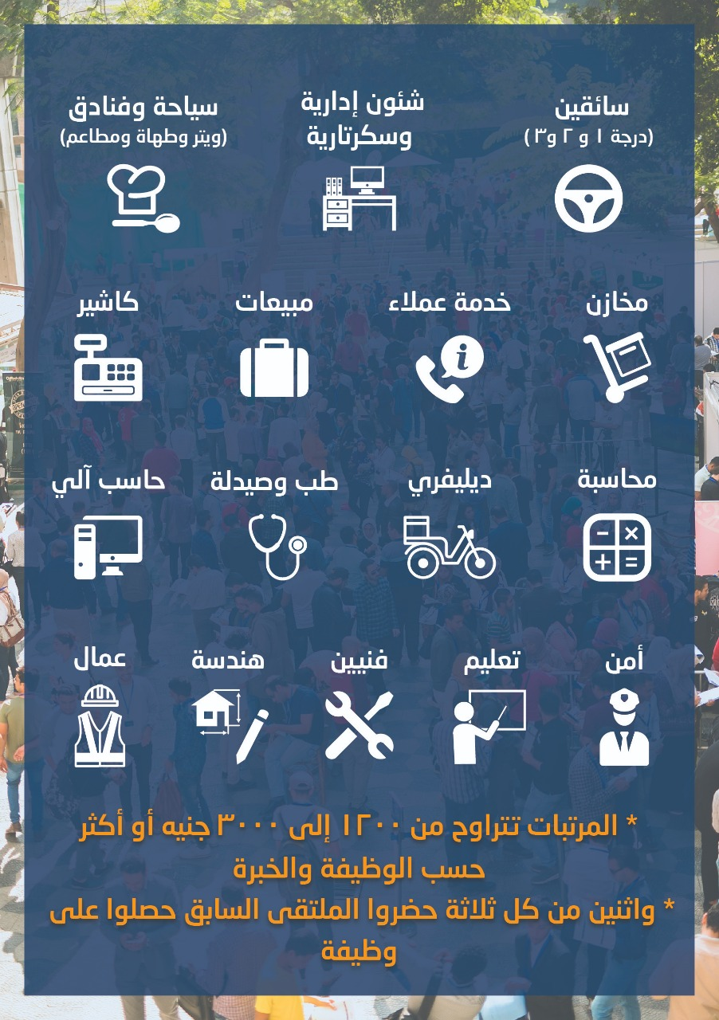

Slide 26
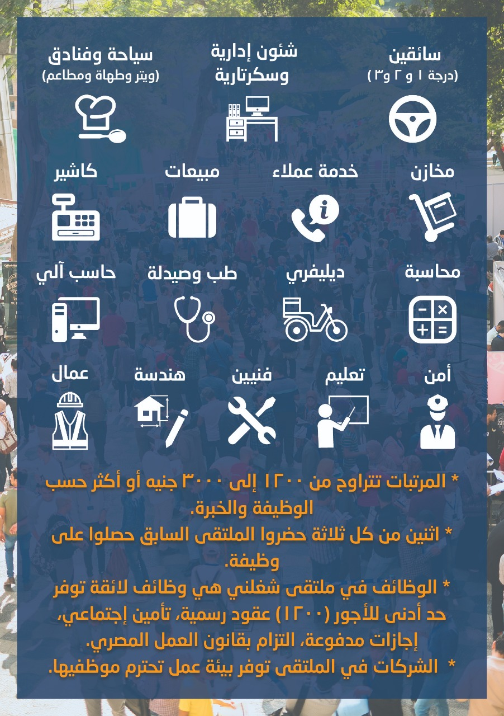

Slide 27
